Slide 1
Welcome to Year 3/4

Slide 2
 | Mon | Tues | Weds | Thurs (GM PPA) | Fri
Y3 | Mr Marron (Science,PE) | Mrs Robinson (PSHE, Computing or Music) | Mrs Robinson (DT) | Mrs Abril (MFL, PE -Sports coach | Mr Marron (Geog)
Y4 | Mrs Robinson (PSHE, Computing or Music) | Mr Marron (PE, Geog) | Mr Marron (PE, MFL) | Mrs King (science) | Mrs King (DT) (Ana 1.50-2.40)
Y5 | Ms Gentle (PE, Science) | Ms Gentle /Mrs Abril PPA (Geog/MFL) | Ms Gentle (PE, DT) | Mrs Robinson (Computing) | Mrs Robinson (PSHE)

Slide 3
Futura Learning Partnership values
The trust’s core values were chosen with the help of staff, pupils and governors:
Children benefit from being part of the Futura Learning Partnership family of schools where teachers and leaders work together across schools to provide the best possible education and enrichment
Children can enjoy access to the Trust’s fantastic facilities at its other schools and teachers will organise these.
Respect | Opportunity | Collaboration | Aspiration
Behaving with integrity and worthy of trust; respecting yourself, others and the environment | Providing experiences for growth and development, opening doors for future success | Working together, towards shared goals and success; being strong together | Encourage ambition; providing the inspiration, challenge and support to achieve success in all its forms

Slide 4
School Vision and values
At The Meadows Primary School, children are at the heart of all we do.
We welcome all children and their families to join our nurturing and inclusive school community. The Meadows offers fun and positive experiences that create lasting memories. Children experience a rich, creative and challenging curriculum that leads to lifelong curiosity and big dreams!
We provide a safe environment that develops resilience and encourages children to take risks, whilst learning from their mistakes. We see every child as an individual and support them on their journey to achieve success.
At The Meadows children will spread their wings and fly, with the belief that anything is possible.
Focus, Flourish and Fly.
Our school values
Honesty | Kindness | Respect | Self-belief

Slide 5
Uniform
Our school uniform consists of:
Boys: Grey trousers or shorts, royal blue jumper and a white shirt/white or royal blue polo shirt. Black school shoes.
Girls: Grey skirt/shorts/skorts or pinafore, royal blue jumper/cardigan, white blouse/white or royal blue polo shirt, and grey tailored trousers for winter wear. In the summer, a blue gingham dress can be worn.
Black school shoes/trainers – if trainers, they need to be all black.
Mobile phones – Children can ONLY bring these in if they are walking home alone and they should be handed to the class teacher – Year 5 & 6 only.
Hair - Long hair will need to be tied back as a preventative measure against the spread of headlice.
Any hair colours not considered by the school to be a natural colour, are not permitted. Make up and nail varnish is not permitted.
Jewellery – Only small, round studs may be worn and these must be removed for PE and outdoor exercise. Please do not wear on these days if children cannot remove themselves.

Slide 6
PE Kit
Please ensure that your child brings in their PE kit in a named bag on their PE days.
For Y3 – Mon/Thurs; Y4 Tues/Weds; Y5 Mon/Weds
These days are changeable, so we suggest PE kit stays in school all week.
A full kit consists of:
Black shorts/skorts
white plain t-shirt (No logos or football shirts)
Daps or trainers and socks.
A plain, dark hoodie/sweater and jogging bottoms can be worn during colder weather.

Slide 7
School day
Teachers will be on the playground at 8:50am
We encourage children to walk or scoot to school. We have our scooter pods for those who choose to do so. If you do need to travel by car, please be considerate of our neighbours when parking at drop off and pick up times.
Whistle will be blown at 8:55am
Children who arrive late must report to reception to sign in.
School day finishes at 3:30pm
Please let the office know if a different family member is collecting your child on a day, even if it is just once. This is for safeguarding purposes.
Y5 & Y6 may walk home at the end of the day, but a written permission letter must be emailed in and signed off by the Mr Edwards (Headteacher) – Even if you did this last year, this must be done again.
If someone else is collecing your child, we now have a password system. Only siblings over 16 should collect.

Slide 8
Inhalers
All children will have taken their inhalers home at the end of the last academic year.
Children requiring inhalers – these must be brought into school (named) and a inhaler permission form will need to be filled out.
This can be done via the office when you bring the inhaler into school – it must be completed by their parent/guardian.

Slide 9
Resources
Children will be supplied with all of the stationery and equipment that they need.
No pencil cases are needed.
We may ask for donations of resources for learning in lessons. Teachers will ask for these ahead of time.

Slide 10
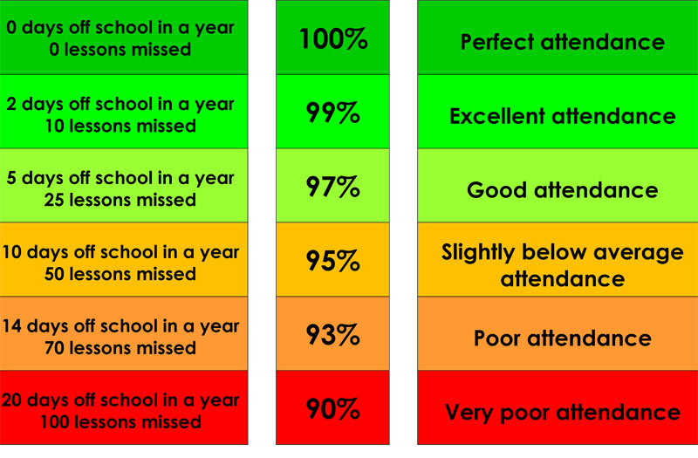
Attendance
At 9:10am, children will be classed as late
After 9.20am, it is marked as an unauthorised absence for the morning session.
Term Dates
Dates for academic terms are published on the school website before the start of each academic year.
Illness
If your child is too ill to attend school, you MUST contact the school on the first and each subsequent day of absence on the school absence line before 8.45am. If you child is suffering with diarrhoea and/or vomiting, please allow 48 hours after this has ceased.
If you’re unsure whether or not your children should attend, we suggest speaking with the school office.

Slide 11
School dinners
Our school meals are provided by Zest Catering, Futura Learning Partnership’s in-house catering service. The management team at Zest prides itself on a "fresh, healthy and tasty" ethos. They are happy to support children with food allergies or intolerances.
Dinner money is £2.61 per dinner.
School meals are free for all pupils in Reception, Year 1 and Year 2 in state schools in England. These are known as 'universal free school meals’.
school menu from Sept 2023

Slide 12
Could you be eligible for Pupil Premium funding?
If so, as well as getting a free school lunch, your child will get access to free breakfast club and toast at playtime as well as the school receiving funding to support your child in a range of different ways.
We are also offering a free school jumper, if a successful application is made this term.
Please see the letter that has been emailed out to all parents.
If you need any support with this, please contact Mrs Holmes, who is our Pupil Premium lead.

Slide 13
Behaviour
The Meadows Primary School is committed to creating an environment where exemplary behaviour is at the heart of productive learning. Everyone is expected to maintain the highest standards of personal conduct, to accept responsibility for their behaviour and encourage others to do the same. As members of our community, we adhere to the values of being: ‘Honest, Kind and Respectful.’ These values are how we expect children to behave.
We promote positive learning :
- house points.
- Praise pads/postcard home
- Wow certificates
- Celebration certificates (weekly)
- Above and beyond afternoon tea

Slide 14
Raindrops – only 3 displayed in class
Level 1 – children will have a warning and a verbal agreement of understanding between adult and child will be made. Staff may need to speak to parents at the end of the day to inform them of behaviours they are noticing
Level 2 – Child will have reflection time in a partner class – a restorative conversation will be held. Staff may need to speak to parents at the end of the day to inform them of behaviours they are noticing
Level 3 – Child will have reflection time with a member of SLT during a breaktime/or immediately. Strategies will be planned to be successful moving forwards. Teacher will telephone/speak with parents at the end of the day. If behaviour is persistent, SLT monitor patterns and write to parents to arrange a meeting.
Level 4 and Level 5 are in place – see the policy for further information on these

Slide 15
Anti-Bullying
The repetitive, intentional hurting of one person by another.
(STOP: Several times on purpose)
Bullying can be carried out physically, verbally emotionally or online.
Bullying of any kind is unacceptable at our school
Everyone has the right to feel welcome, safe and happy
We should treat everyone with respect
If bullying happens it will be dealt with quickly and effectively
Please click on the link to see our Anti-Bullying policy for further detail.
Policies

Slide 16
Homework
Maths Homework – Checked on Fridays
Children will be using DoodleMaths and are expected to complete their weekly target of stars. They are tracked over 7 days and this resets again each week. If children fail to complete their target, this will be discussed with the child and they will be asked to complete it during ‘free time Friday’. If children consistently fail to reach their target, this will be discussed with parents and carers.
Timestables practice – children will reach either their target stars on DoodleTables, or complete a set number of minutes on TT Rockstars.
Y4 will take part in the multiplication check in June. There will be an information evening closer to the time but they need to know all tables up to and including 12s.
English homework
In KS2 children will have 5-8. Please ensure children practice these at home as well as learning words from the statutory spelling list. (Checked on Mondays)
We expect to see these practised 3 times each week with one of these contextual.
Please also read with your child 4 times per week – asking questions to further their understanding of the text. (Checked on Fridays)

Slide 17
English
WRITING
We plan our English around a text for each term and all writing is based around this high quality text.
Children will be taught a skill and they will practise this, followed by a short writing piece where they apply this school.
Each writing unit will have long writing outcomes as well.
Children will learn their grammar curriculum within their English lessons
READING
Whole class reading lessons take part every day and we follow VIPERS.
VIPERS focuses on all the different reading skills and children spend time reading texts as well as building their comprehension skills.

Slide 18
Trips and visitors
We like to provide our learners with lifelong memories and encourage their curiosity to learn.
Although contributions are voluntary, schools are not in financial positions to fund these enrichment experiences.
We have a generous PTA that can sometimes subsidise many experiences but we do need parental contributions as well.
We realise times are difficult at the moment and it is essential that you speak to the office this term if you feel you will be unable to make payments this year, so the school can try and budget for this.
If we have not heard that you need support with trip contributions then we will expect payments to be made.
Please try and make payments on time or speak to the office if you need a bit more time – it makes things much easier to organise and navigate.
If we do not get enough support with this then trips and experiences will be unable to go ahead.

Slide 19
Current trips for Y3/4/5
Y3/4 T2: Bristol Museum
Y5 T2: Steam museum
Y4 T: Residential
Swimming: TBC

Slide 20
How can you support your child?
Practice your child’s maths homework and spellings with them frequently
Recap previous learning too.
Practice the methods taught in maths with your child to build fluency.
Buy your child a watch and get them to tell the time as much as possible.
Use the websites and apps, including TT Rockstars and Doodle, shared with you to support your child.
Read with your child every day to support their fluency, expression, reading comprehension and vocabulary
Mobile phones: Children to only bring them into school if they are walking home on their own. Please see these links regarding being safe online and cyber bullying: Staying safe online & online bullying
During the day they must be switched off and handed into the class teacher.

Slide 21
Assessment
Assessments will be done 3 times a year.
They are statutory and children must sit them.
We will continue to assess children’s writing based on judgements, with moderations within the Futura Learning Partnership and South Gloucestershire.
We will have pupil progress meetings to identify and intervene with children that are off-track.
We will inform you if this is happening for your child.

Slide 22
Contact us
Playground (Teachers are available on the playground from 8:50-8:55 for quick messages/chats.)
Email/phone school office – all messages will be forwarded onto teachers and you will get a response.
If you require an appointment for something that needs longer, this can be made via email.

Slide 23
Assemblies
Whole School Assemblies
We will deliver three assemblies per week. These will be focused on our personal development curriculum.
Celebration assembly – These are every Friday at 2:45pm.
Parents of nominated children will receive a letter inviting them to attend.
If you cannot attend, you can contact the office and we can move it to the following week.

Slide 24
Photo consent
If you have not completed a form to say that you are happy or not happy for your child’s image to be used then please email/phone the office ASAP and they will get one to you.

Slide 25
Thank you

